Slide 1

COMPUTER PROGRAMMING PROJECT
Submitted by:
Mamoon Akhtar (048) Leader
Abdullah Khalid (007)
Muhammad Abdullah (052)
Farquleet Ahsan (027)
Feeman(031)
Submitted to:
Sir Sauood

Slide 2
JOB World
Job Application

Slide 3
INTRODUCTION:
Welcome to our advanced Job Portal, crafted for seamless job hunting and efficient recruitment. With five intuitive options, our portal ensures a smooth user experience:
Create a New Company:
Register your company effortlessly, providing essential details to make your job opportunities visible to potential applicants.
Add Details for Your Company:
Enrich your company profile by supplying additional information, showcasing your culture, values, and unique offerings to attract top talent.
Apply for a Job:
Job seekers can effortlessly submit applications to registered companies, streamlining the job application process.
Display Available Companies:
Explore diverse job opportunities by accessing a comprehensive list of registered companies aligned with your career goals.
Exit:
Conclude your interaction seamlessly. Clicking "Exit" ensures a smooth exit from the program.

Slide 4

Objectives
Create an easy-to-use platform for job seekers to find jobs that match their skills, qualifications, and preferences easily.
Help companies display their job openings, company culture, and values to attract suitable candidates.
Simplify the job application process for candidates, making it easy to apply for multiple positions using a standardized application format.
Offer job seekers educational resources, career advice, and industry insights to assist them in making well-informed career decisions.

Slide 5
Components use in Program
Libraries
#include <iostream>
#include <fstream>
#include <vector>
#include <string>
Structure (for company and candidate)(in global)
Switch case(5 cases)
File handling(to save and create file)
Functions( display company ,create company , applicant details and display applicant details)

Slide 6
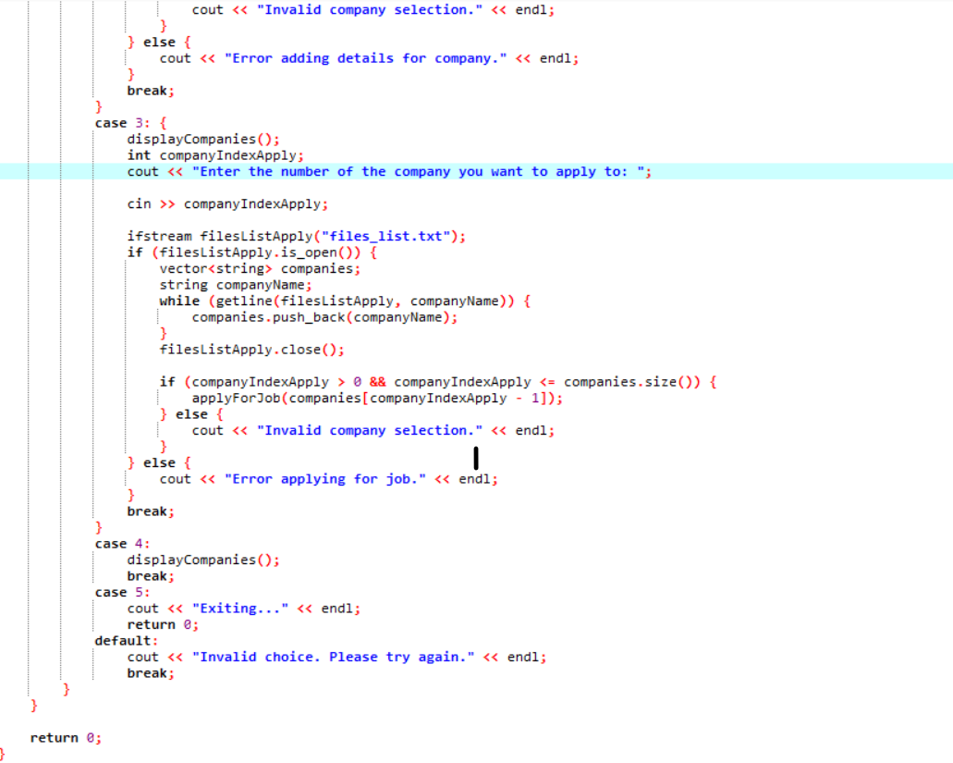
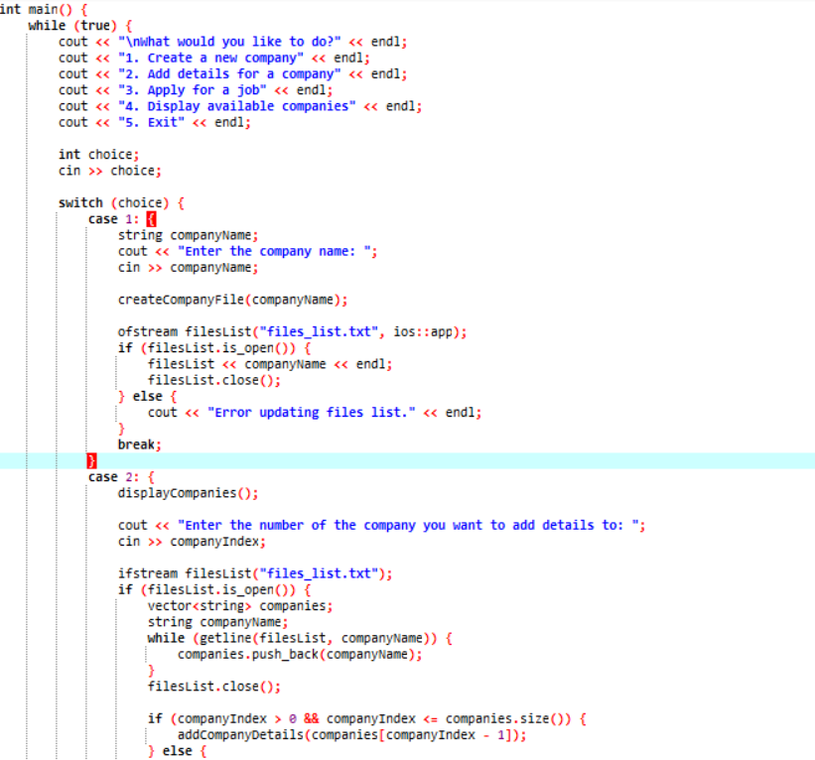
Main

Slide 7
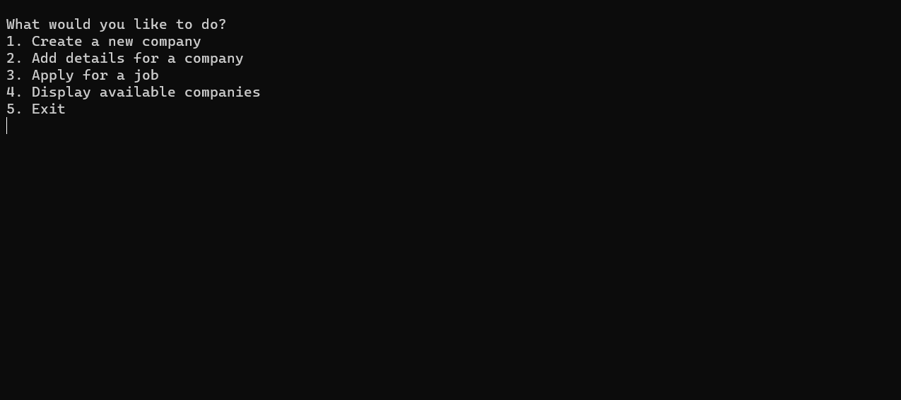
Creating company
// Function to create a new company file
void createCompanyFile(const string& companyName) {
ofstream file((companyName + ".txt").c_str(), ios::app);
if (file.is_open()) {
file << "Applicant Details:\n";
file.close();
cout << "Company file '" << companyName << ".txt' created." << endl;
} else {
cout << "Error creating company file." << endl;
}
}

Slide 8
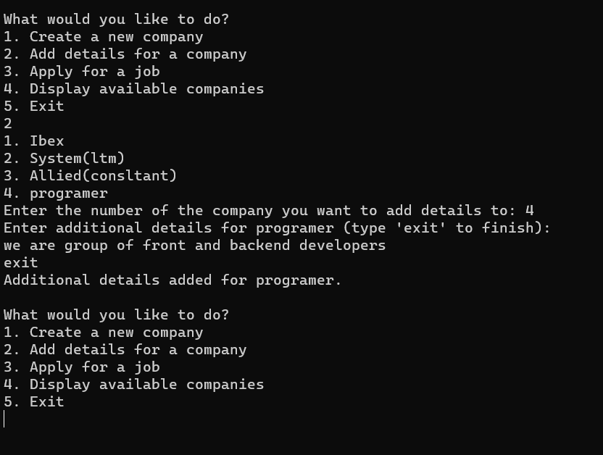
Company details
// Function to add details for a company
void addCompanyDetails(const string& companyName) {
ofstream file((companyName + ".txt").c_str(), ios::app);
if (file.is_open()) {
string companyDetails;
cout << "Enter details for " << companyName << " (type 'exit' to finish):" << endl;
while (true) {
getline(cin, companyDetails);
if (companyDetails == "exit") {
break;
}
file << companyDetails << endl;
}
file.close();
cout << "Additional details added for " << companyName << "." << endl;
} else {
cout << "Error adding details for " << companyName << "." << endl;
}
}

Slide 9
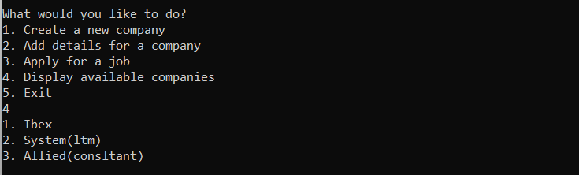
Display company Companies
// Function to display available companies
void displayCompanies() {
ifstream filesList("files_list.txt");
if (filesList.is_open()) {
string companyName;
int count = 1;
while (getline(filesList, companyName)) {
cout << count << ". " << companyName << endl;
count++;
}
filesList.close();
} else {
cout << "Error displaying available companies." << endl;
}
}

Slide 10
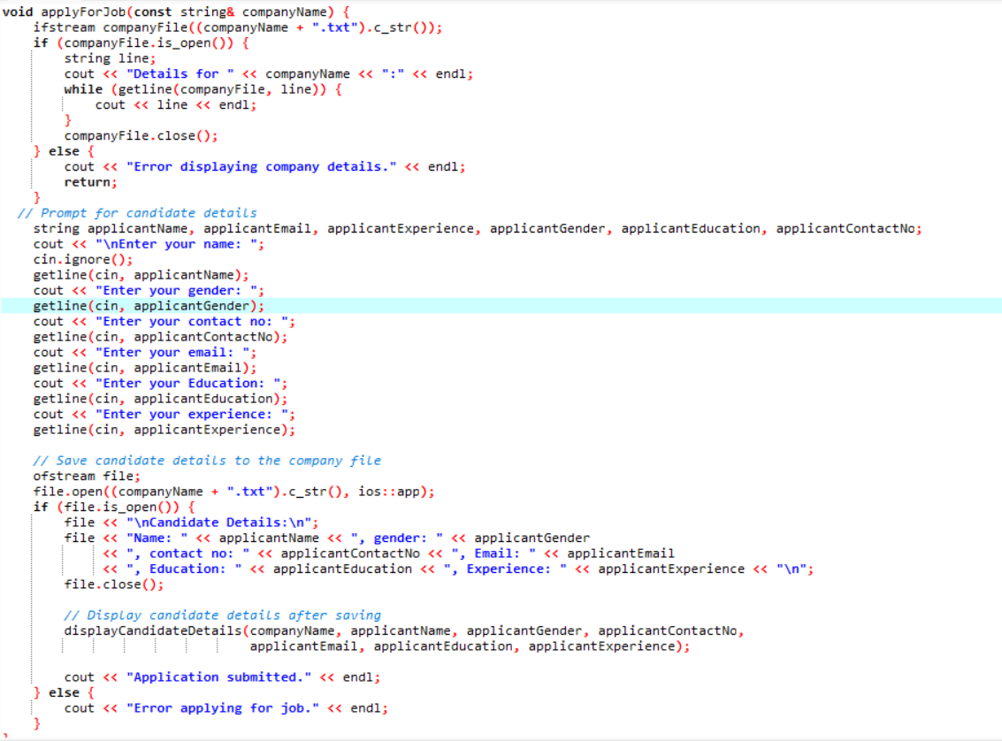
Candidate Details
Code for apply job
Code for display candidate detail
void displayCandidateDetails(const string& companyName, const string& applicantName,
const string& applicantGender, const string& applicantContactNo,
const string& applicantEmail, const string& applicantEducation,
const string& applicantExperience) {
cout << "\nCandidate Details for " << companyName << ":" << endl;
cout << "Name: " << applicantName << "\nGender: " << applicantGender
<< "\nContact No: " << applicantContactNo << "\nEmail: " << applicantEmail
<< "\nEducation: " << applicantEducation << "\nExperience: " << applicantExperience << "\n";
}

Slide 11
Reference:
Presenting "Job World" – a revolutionary job portal inspired by Jobee's user-centric model. With an intuitive interface, smart matching algorithms, and mobile accessibility, Job World optimizes the job search process. Our innovative application system, emphasis on company culture insights, and robust security measures echo Jobee's influence. Committed to continuous improvement, Job World aspires to redefine industry standards, offering a seamless and informed experience for job seekers and employers alike.

